Slide 1
Module 4 Basic Query Formulation with SQL
Lesson 4: Using join operations in SQL SELECT statements
Notes:
Welcome to lesson 4 of Module 4 on basic query formulation with SQL
Query formulation is an important skill in application development.
Everyone involved in the application development must be competent in query formulation.
Most students will be involved (at least initially) in application development rather than in a role as a database specialist. Database specialists must also understand query formulation and SQL.
Opening question:
- What join operator style do you prefer?

Slide 2
Lesson Objectives
Write SELECT statements using both join styles
Provide natural language explanations of SELECT statements using both join styles
Notes:
Read and write statements using both join styles
Concentrate on syntax. Later lessons will emphasize analysis of a problem statement.

Slide 3
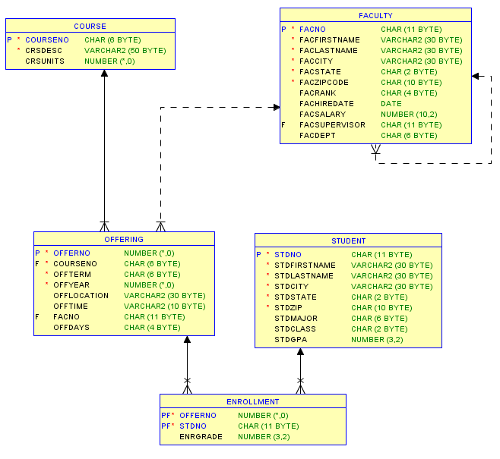
University Database Diagram
Notes:
Use university database for examples
University database was covered in previous modules so you should be familiar with it.
When formulating problems involving the join operator (typically used to combine tables), you should know the relationships in a database diagram.
Review examples: circle tables and relationships
Faculty and Offering tables
Faculty, Offering, and Course tables

Slide 4
Cross Product Style
List tables in the FROM clause
List join conditions in the WHERE clause
Example 1
SELECT OfferNo, CourseNo, FacFirstName, FacLastName
FROM Offering, Faculty
WHERE OffTerm = 'FALL' AND OffYear = 2012
AND FacRank = 'ASST' AND CourseNo LIKE 'IS%'
AND Faculty.FacNo = Offering.FacNo;
Notes:
Meaning: details of offerings and assigned faculty for fall 2012 IS courses taught by assistant professors
Cross Product Style:
- Name comes from derivation of the join operator using the cross product operator
- Join is equivalent of a cross product, selection (retain just matching rows)
Extension for multiple tables:
- Add tables to the FROM clause
- Add join conditions to the WHERE clause
Order of tables and join conditions is NOT order dependent
Oracle version: use % instead of *

Slide 5
Join Operator Style
Use INNER JOIN and ON keywords
FROM clause contains join operations
Example 2
SELECT OfferNo, CourseNo, FacFirstName, FacLastName
FROM Offering INNER JOIN Faculty
ON Faculty.FacNo = Offering.FacNo
WHERE OffTerm = 'FALL' AND OffYear = 2012
AND FacRank = 'ASST' AND CourseNo LIKE 'IS%';
Notes:
Join Operator Style:
- SQL:2011, Oracle, MySQL, and Access
Extension for multiple tables:
- Conceptually no need for parentheses because join is associative
(order of operations does not matter)
- Nested parentheses are difficult to read
- Harder to find the tables in the statement

Slide 6
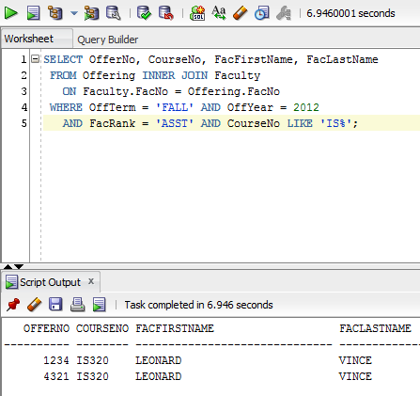
SQL Developer Usage
Notes:
Execution of SELECT statement in the SQL Developer

Slide 7
Name Qualification
Ambiguous column reference
More than one table in the query contains a column referenced in the query
Ambiguity determined by the query not the database
Use column name alone if query is not ambiguous
Qualify with table name if query is ambiguous
Notes:
Ambiguous:
- More than one table in the query contains a column referenced in the query
- Ambiguity determined by the query not the database
Readability:
- qualified names are easier to read (no context to imply)
Writability:
- Unqualified names require fewer keystrokes (less work)
Column naming convention:
- Table name abbreviation: Std for Student
- Column names easy to associate with tables without qualification

Slide 8
Name Qualification Example
Example 2
SELECT OfferNo, CourseNo, FacFirstName, FacLastName
FROM Offering INNER JOIN Faculty
ON Faculty.FacNo = Offering.FacNo
WHERE OffTerm = 'FALL' AND OffYear = 2012
AND FacRank = 'ASST' AND CourseNo LIKE 'IS%';
FacNo must be qualified
Can qualify other names for easier readability
Notes:
Example 2:
- Offering and Faculty tables
- Reference to FacNo is ambiguous unless qualified
- Reference to CourseNo is not ambiguous: Course table is not in the query
Name qualification:
FacNo must be qualified because of ambiguity (column in both Offering and Faculty tables)
You can qualify other columns
Readability: qualification makes it easier for others to read your statements (no need to remember table names for each column)
Writability: using the fully qualified name takes more effort when writing the query
Maintainability: using the fully qualified name ensures that ambiguity does not exist if a matching column name is added to another table (adding the OffYear column to Faculty); this is not a likely problem; in most situations, maintenance is not an issue
For the most part, use of qualification when there is no ambiguity is a matter of preference

Slide 9
Cross Product Style with 3 Tables
Example 3: List Leonard Vince’s teaching schedule in fall 2012. For each course, list the offering number, course number, number of units, days, location, and time.
SELECT OfferNo, Offering.CourseNo, OffDays,
CrsUnits, OffLocation, OffTime
FROM Faculty, Course, Offering
WHERE Faculty.FacNo = Offering.FacNo
AND Offering.CourseNo = Course.CourseNo
AND OffYear = 2012 AND OffTerm = 'FALL'
AND FacFirstName = 'LEONARD'
AND FacLastName = 'VINCE';
Notes:
List Leonard Vince’s teaching schedule in fall 2012. For each course, list the offering number, course number, number of units, days, location, and time.
3 tables, 2 join conditions

Slide 10
Join Operator Style with 3 Tables
Example 4: List Leonard Vince’s teaching schedule in fall 2012. For each course, list the offering number, course number, number of units, days, location, and time.
SELECT OfferNo, Offering.CourseNo, OffDays,
CrsUnits, OffLocation, OffTime
FROM Offering INNER JOIN Course
ON Offering.CourseNo = Course.CourseNo
INNER JOIN Faculty ON Offering.FacNo = Faculty.FacNo
WHERE OffYear = 2012 AND OffTerm = 'FALL'
AND FacFirstName = 'LEONARD'
AND FacLastName = 'VINCE';
Notes:
List Leonard Vince’s teaching schedule in fall 2012. For each course, list the offering number, course number, number of units, days, location, and time.
3 tables: 2 join operations
Not as easy to read because tables are hidden in the join operations

Slide 11
Summary
Explicit join specification in the SELECT statement
Read and write both join styles
Consult database diagram when formulating join queries
Work many problems
Notes:
Join operator is essential because business databases typically have many tables. Extracting useful information typically requires more than one table, sometimes many tables.
SELECT statement has the NATURAL JOIN operator but it is easier to read with explicit specification of join conditions.
Knowledge of database diagram essential as the number of tables increases in a query
What join style do you prefer? I prefer the cross product style because it is easier to read.

